Slide 1


Amateur Extra Licensing Class
Receivers with Great Filters
Presented by
W5YI
Arlington, Texas

Slide 2
Amateur Radio Extra Class
Element 4 Course Presentation
ELEMENT 4 Groupings
  Rules & Regs
  Skywaves & Contesting
  Outer Space Comms
  Visuals & Video Modes
  Digital Excitement with Computers & Radios
  Modulate Your Transmitters
  Amps & Power Supplies
  Receivers with Great Filters

Slide 3
Amateur Radio Extra Class
Element 4 Course Presentation
ELEMENT 4 Groupings
  Oscillate & Synthesize This!
  Circuits & Resonance for All!
  Components in Your New Rig
  Logically Speaking of Counters
  Optos & OpAmps Plus Solar
  Test Gear, Testing, Testing 1,2,3
  Antennas
  Feedlines & Safety

Slide 4
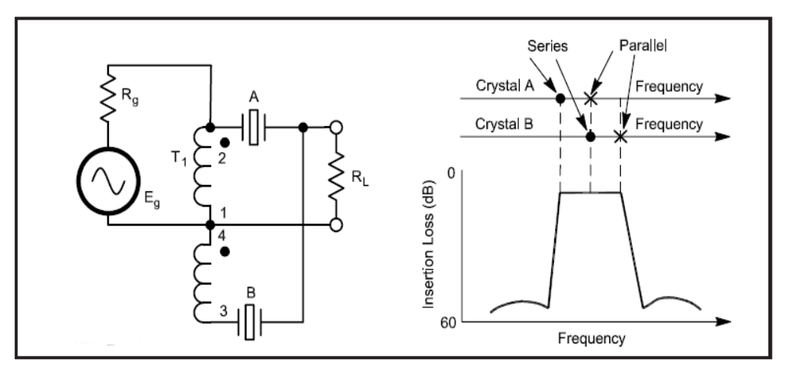
Amateur Radio Extra Class
Receivers with Great Filters
E6E02… A filter bandwidth of 6 kHz at -6 dB would be a good choice for use with standard double-sideband AM transmissions.
E6E03… A crystal lattice filter is a filter with narrow bandwidth and steep skirts made using quartz crystals.

Slide 5
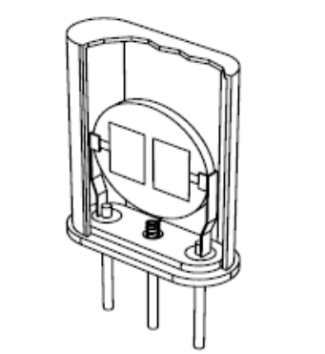
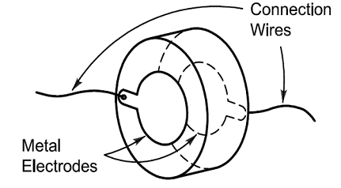
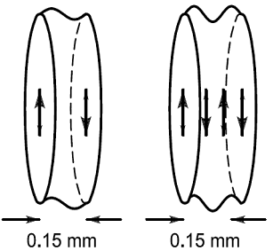
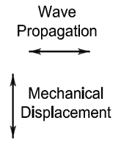
Amateur Radio Extra Class
Receivers with Great Filters
E6E06… One aspect of the piezoelectric effect is the physical deformation of a crystal by the application of a voltage.

Slide 6
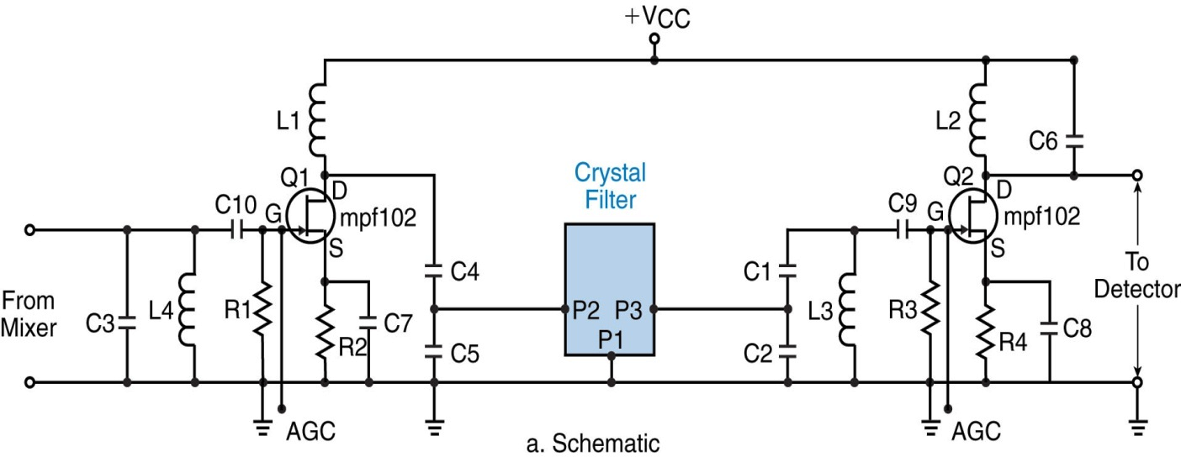
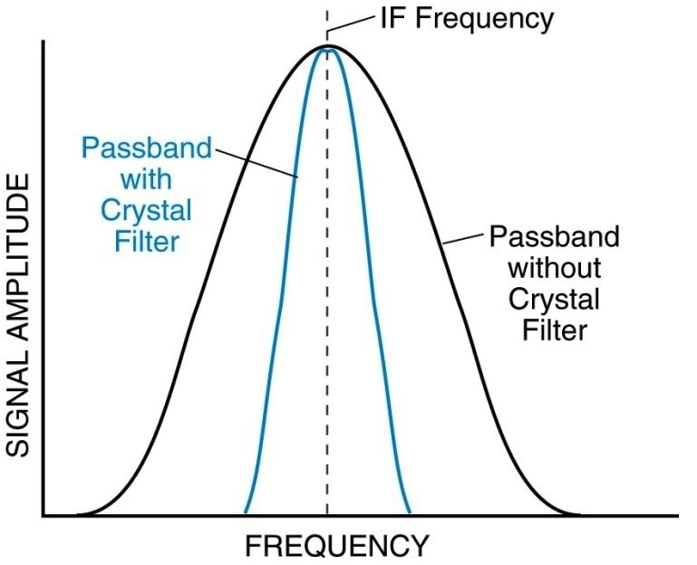
Amateur Radio Extra Class
Receivers with Great Filters
AGC - Automatic Gain Control applied at the points indicated.
Effect of Crystal Filter on Passband
Cascaded IF amplifiers. The active devices are JFETs. The value of most components depends upon the frequency of operation.

Slide 7
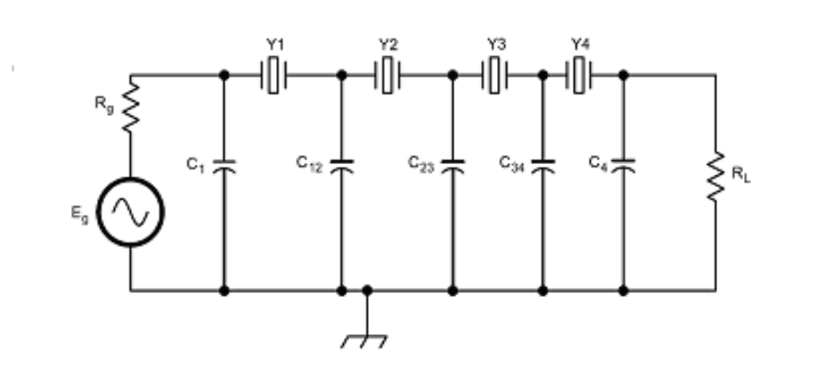
Amateur Radio Extra Class
Receivers with Great Filters
E6E04… The technique used to construct low-cost, high-performance crystal ladder filters is to measure crystal frequencies and carefully select units with a frequency variation of less than 10% of the desired filter bandwidth.
E6E05… The relative frequency of the individual crystals has the greatest effect in helping determine the bandwidth and response shape of a crystal ladder filter.

Slide 8
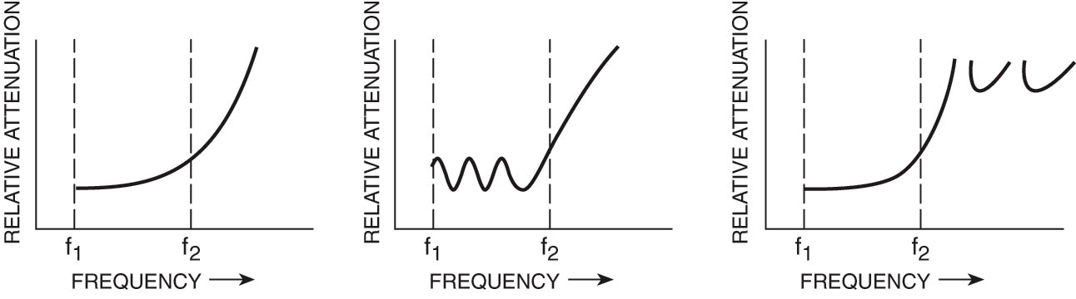
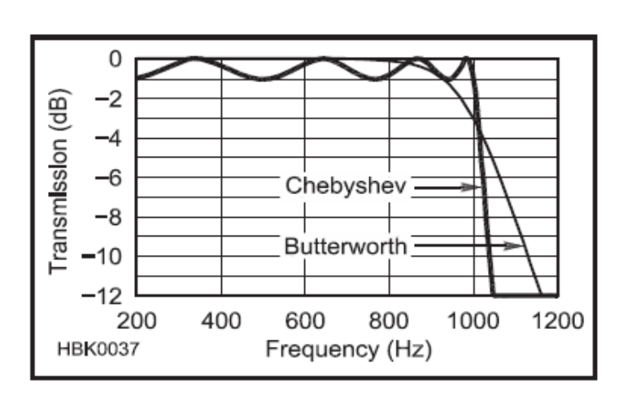
Amateur Radio Extra Class
Receivers with Great Filters
E7C05… A Chebyshev filter type is described as having ripple in the passband and a sharp cutoff.
Butterworth Chebyshev Elliptical
Outside passband
Inside passband
Sharp Cutoff

Slide 9
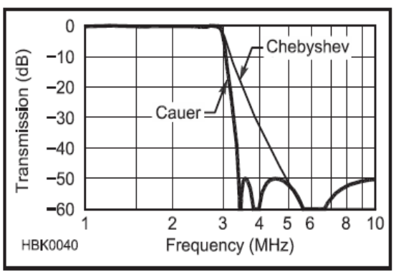
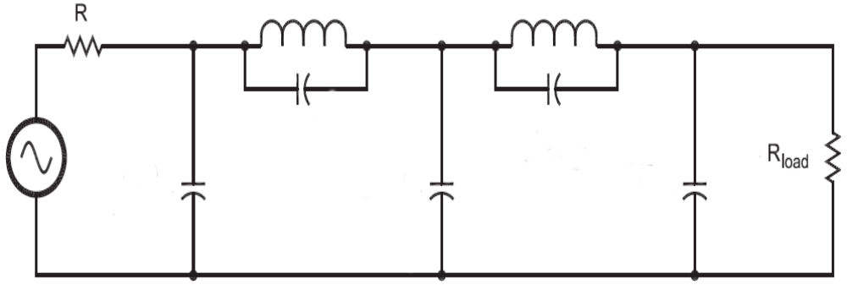
Amateur Radio Extra Class
Receivers with Great Filters
E7C06… The distinguishing features of an elliptical filter is extremely sharp cutoff, with one or more infinitely deep notches in the stop band.
E4C03… Capture effect is the term for the blocking of one FM phone signal by another, stronger FM phone signal.
E4C02… As a result of the capture effect in an FM receiver the strongest signal received is the only signal demodulated.

Slide 10
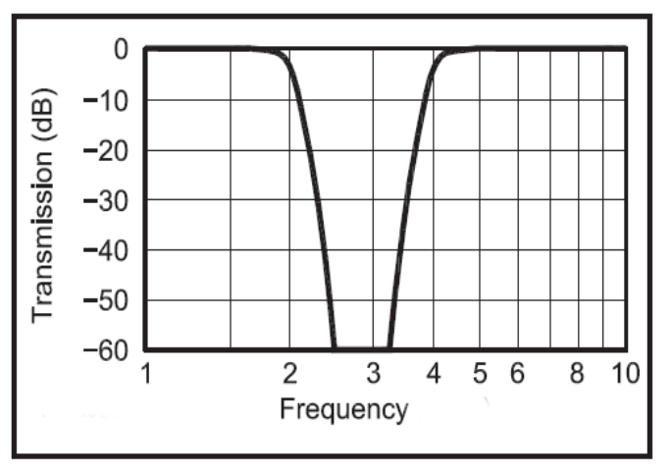
Amateur Radio Extra Class
Receivers with Great Filters
E7C07… An audio notch filter would be used to attenuate an interfering carrier signal while receiving an SSB transmission.
E7C08… An adaptive filter type of digital signal processing audio filter might be used to remove unwanted noise from a received SSB signal.
Deep notch

Slide 11
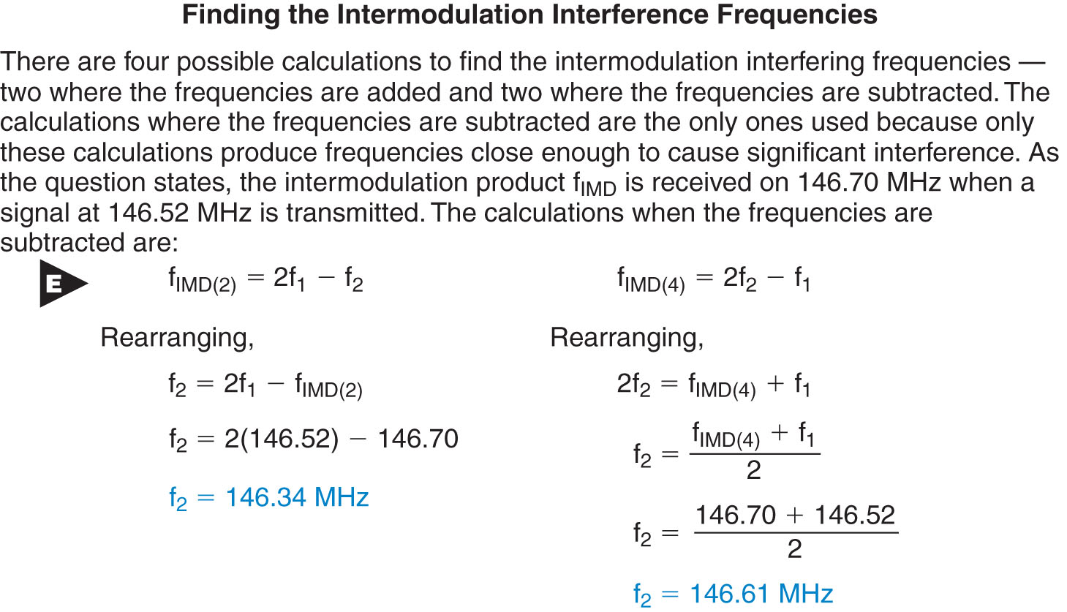
Amateur Radio Extra Class
Receivers with Great Filters
E4D05… If a receiver tuned to 146.70 MHz receives an intermodulation-product signal whenever a nearby transmitter transmits on 146.52 MHz, the two most likely frequencies for the other interfering signal is 146.34 MHz and 146.61 MHz.

Slide 12
Amateur Radio Extra Class
Receivers with Great Filters
E4D07… The most significant effect of an off-frequency signal when it is causing cross-modulation interference to a desired signal is that the off-frequency, unwanted signal is heard in addition to the desired signal.
E4C05… The theoretical receiver noise floor at the input of a perfect receiver at room temperature is -174 dBm/Hz.
E4C06… If the thermal noise value of a receiver is -174 dBm/Hz, then the theoretically best minimum detectable signal for a 400 Hz bandwidth receiver would be -148 dBm.
E4C07… The MDS of a receiver represents the minimum discernible signal it could be expected to receive.

Slide 13
Amateur Radio Extra Class
Receivers with Great Filters
E4C08… Lowering the noise figure of a receiver would increase its signal to noise ratio performance (making performance better)
E4C09… In a modern communications receiver operating at 14 MHz the most likely limiting condition for sensitivity would be Atmospheric noise.
E4C12… Using too wide a filter bandwidth in the IF section of a receiver may have the undesirable effect of allowing undesired signals to be heard.
E4C10… A desirable amount of selectivity for an amateur RTTY HF receiver is 300 Hz.

Slide 14
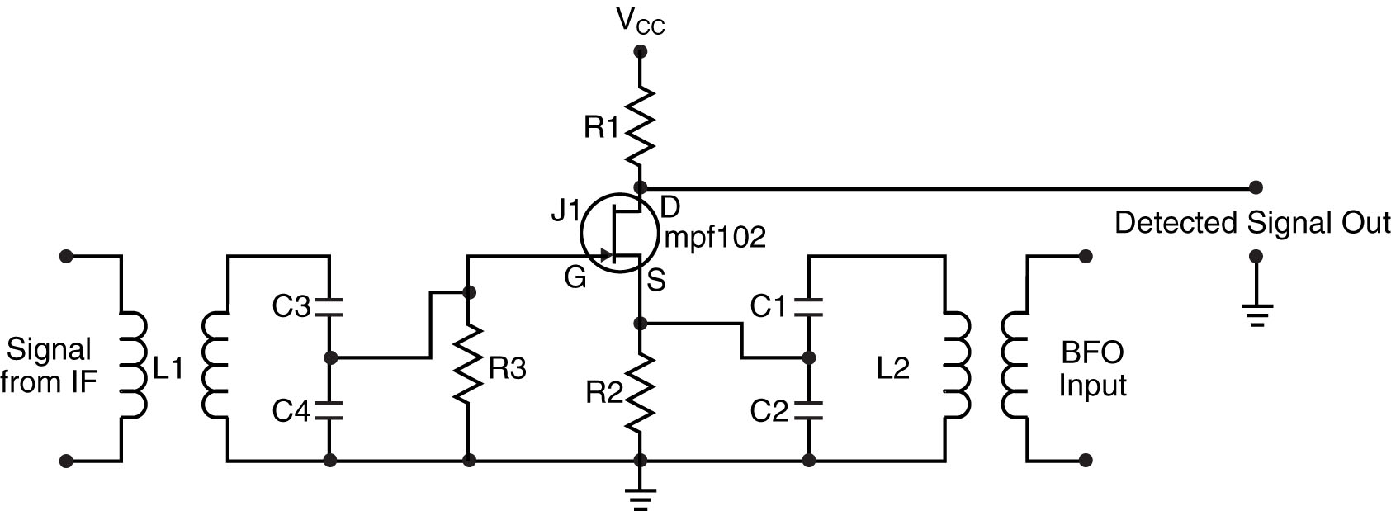
Amateur Radio Extra Class
Receivers with Great Filters
E4C11… A desirable amount of selectivity for an amateur single-sideband phone receiver is 2.4 KHz.
Product detector circuit used for SSB.

Slide 15
Amateur Radio Extra Class
Receivers with Great Filters
E4C13… A narrow band roofing filter can improve performance and dynamic range by keeping strong signals near the receive frequency out of the IF stages.
Roofing filters are placed before the IF stages in a receiver.
E4C14… A desirable amount of selectivity for an amateur VHF FM receiver is 15 kHz.
The bandwidth for each sideband for a 5 KHz deviation voice signal would be the maximum 5 KHZ deviation + the max audio frequency of approx. 2.5 KHz or 7.5 KHz, multiplied by two for the upper and lower sideband would be 15 KHz.
E4C15… Atmospheric noise is the primary source of noise that can be heard from an HF-band receiver with an antenna connected.

Slide 16
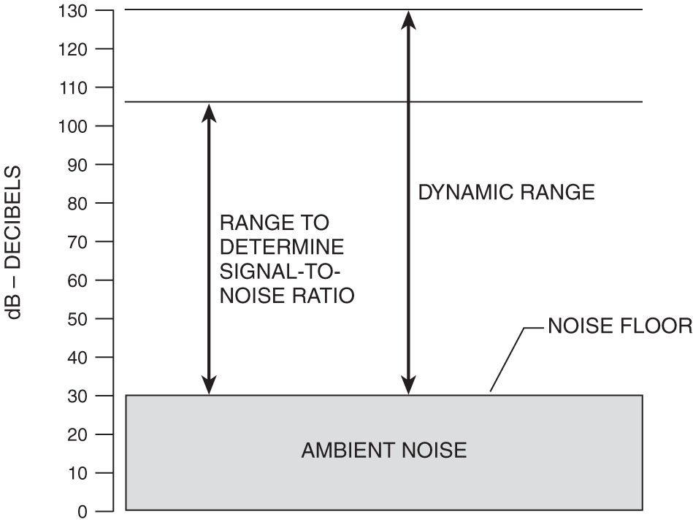
Amateur Radio Extra Class
Receivers with Great Filters
E4C04… The noise floor of a receiver is the equivalent input noise power when the antenna is replaced with a matched dummy load.
Noise Floor in a Receiver
The concept of noise floor is valuable in many radio communications systems and enables the radio receiver design and performance to be matched to the requirements of the overall system.

Slide 17
Amateur Radio Extra Class
Receivers with Great Filters
E4D01… The difference in dB between the level of an incoming signal which will cause 1 dB of gain compression, and the level of the noise floor, is the blocking dynamic range of a receiver.
Blocking dynamic range is measured in decibels at your receiver noise floor, with AGC turned off, and a nearby signal that leads to 1dB of gain compression in the receiver.
E4D02… Cross modulation of the desired signal and desensitization from strong adjacent signals are two types of problems caused by poor dynamic range in a communications receiver.
E4D09… The purpose of the preselector in a communications receiver is to improve the rejection of unwanted signals.

Slide 18
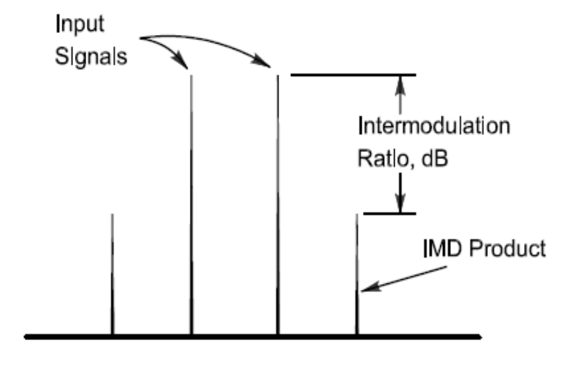
Amateur Radio Extra Class
Receivers with Great Filters
E4D10… A third-order intercept level of 40 dBm with respect to receiver performance means a pair of 40 dBm signals will theoretically generate the same output on the third order intermodulation frequency as on the input frequency.

Slide 19
Amateur Radio Extra Class
Receivers with Great Filters
E4D11… Third-order intermodulation products within a receiver are of particular interest compared to other products. This is because the third-order product of two signals which are in the band is likely to be within the band.
E4D12… Desensitization is the term for the reduction in receiver sensitivity caused by a strong signal near the received frequency.
E4D13… Strong adjacent-channel signals can cause receiver desensitization.
E4D14… Decreasing the RF bandwidth of the receiver is a way to reduce the likelihood of receiver desensitization.

Slide 20
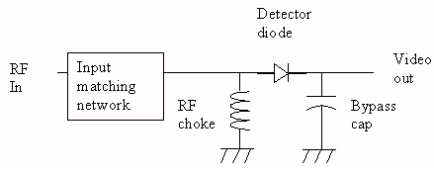
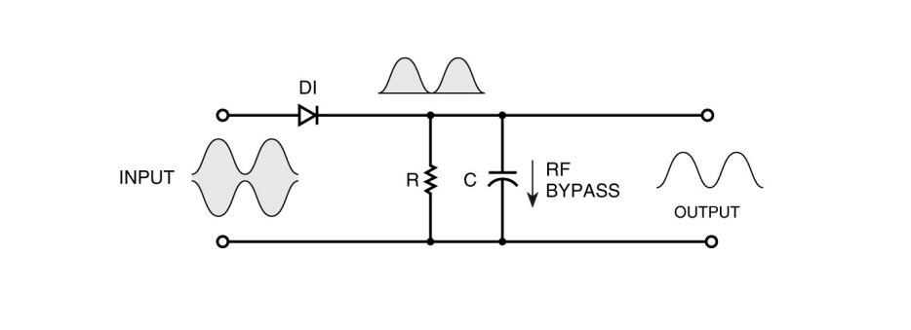
Amateur Radio Extra Class
Receivers with Great Filters
E7E10… The process of detection refers to the recovery of information from a modulated RF signal.
E7E11… The diode detector function is the rectification and filtering of RF signals.
E7E12… A product detector is well suited for demodulating SSB signals.
Basic detector circuits

Slide 21
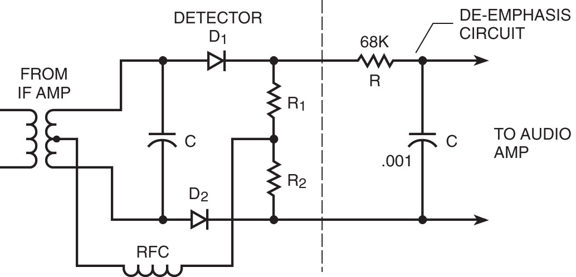
Amateur Radio Extra Class
Receivers with Great Filters
E7E06… A de-emphasis network (circuit) is added to an FM receiver to restore attenuated lower audio frequencies.
E7C14… The phasing or quadrature method describes a common means of generating a SSB signal when using digital signal processing.
FM De-emphasis Circuit

Slide 22
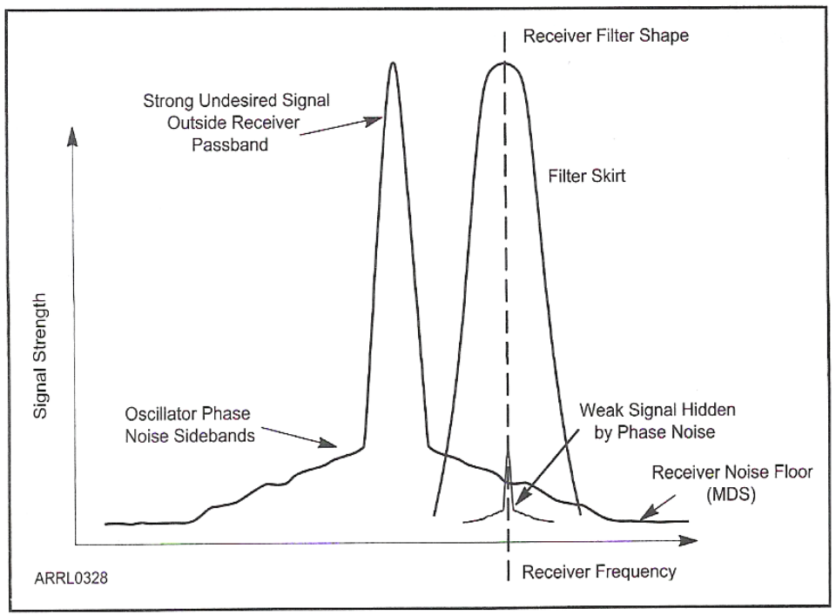
Amateur Radio Extra Class
Receivers with Great Filters
E4C01… The effect of excessive phase noise in the local oscillator section of a receiver can cause strong signals on nearby frequencies to interfere with reception of weak signals.

Slide 23
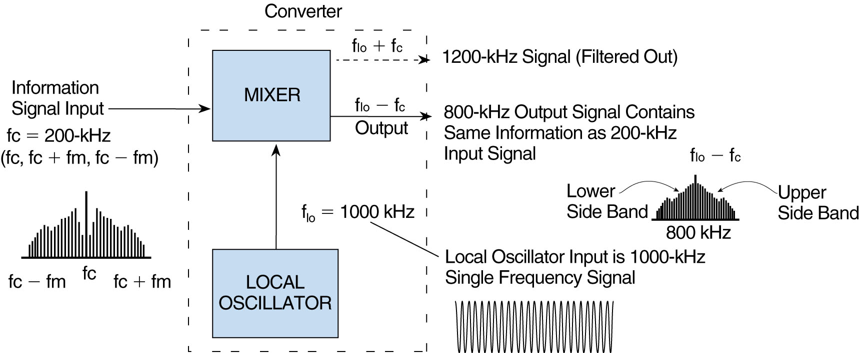
Amateur Radio Extra Class
Receivers with Great Filters
E7E07… One result of the process of mixing two signals is the creation of new signals at the sum and difference frequencies.
Block Diagram Showing Mixer Function

Slide 24
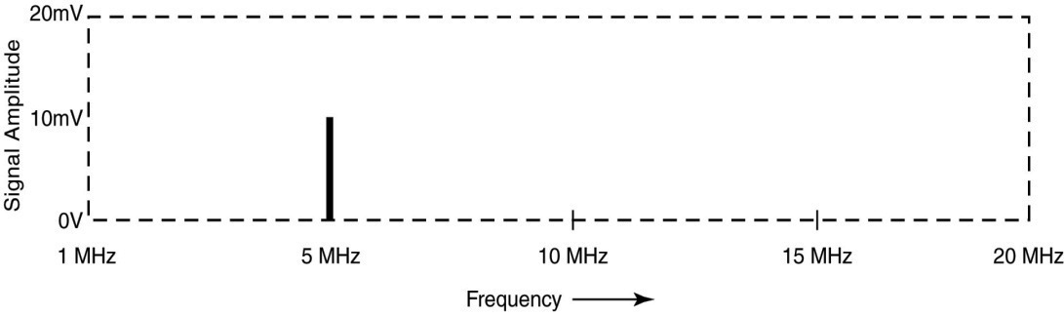
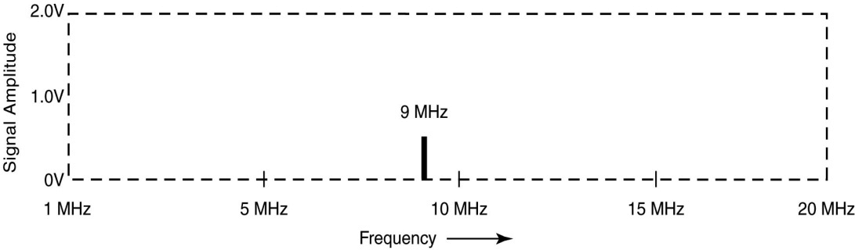
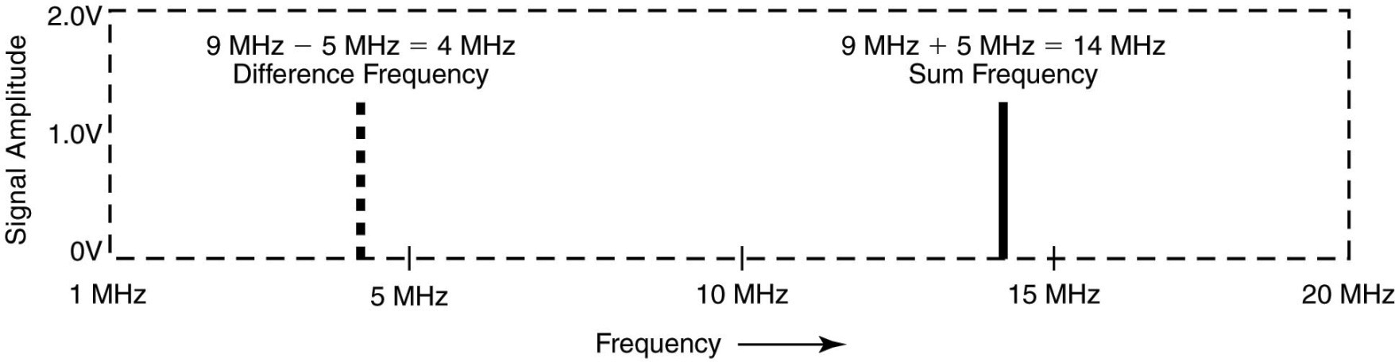
Amateur Radio Extra Class
Receivers with Great Filters
E7E08… The principal frequencies that appear at the output of a mixer circuit are the original frequencies, and the sum and difference frequencies.
5 MHz RF Signal
9 MHz Local Oscillator Signal
Mixer Output (Intermediate Frequencies)
The originals are also present at the output

Slide 25
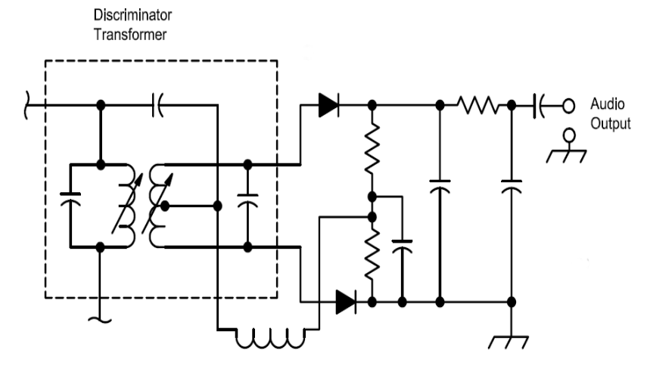
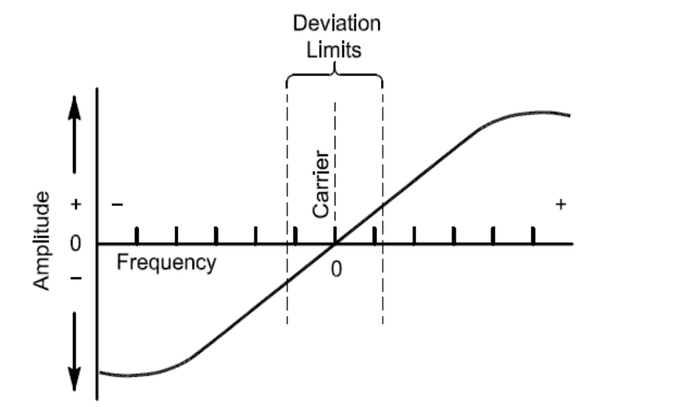
Amateur Radio Extra Class
Receivers with Great Filters
E7E09… Spurious mixer products are generated when an excessive amount of signal energy reaches a mixer circuit.
E7E15… In a “direct conversion” software defined receiver incoming RF is mixed to “baseband” for analog-to-digital conversion and subsequent processing.
E7E13… A frequency discriminator is a circuit for detecting FM signals.
Remember: Discriminators are used in FM and Detectors are used in AM and SSB

Slide 26
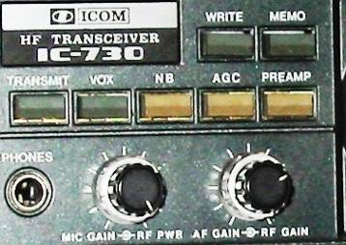
Amateur Radio Extra Class
Receivers with Great Filters
E4E01… Ignition Noise can often be reduced by use of a receiver noise blanker.
E4E02… Broadband “white” noise, ignition noise and power line noise are types of receiver noise can often be reduced with a DSP noise filter.
E4E03… Signals which appear correlated (mathematically similar) across a wide bandwidth might be able to be removed from desired signals with a receiver noise blanker.
Noise Blanker

Slide 27
Amateur Radio Extra Class
Receivers with Great Filters
E4E07… You can determine if line-noise interference is being generated within your home by turning off the AC power line main circuit breaker and listening on a battery-operated radio.
E4E12… One disadvantage of using some automatic DSP notch-filters when attempting to copy CW signals is that the DSP filter can remove the desired signal at the same time as it removes interfering signals.
E4D13… Arcing contacts in a thermostatically controlled device, a defective doorbell or doorbell transformer inside a nearby residence or a malfunctioning illuminated advertising display might be the cause of a loud "roaring" or "buzzing" AC line type of interference that comes and goes at intervals.
E4E14… One type of electrical interference that might be caused by the operation of a nearby personal computer is the appearance of unstable modulated or unmodulated signals at specific frequencies.

Slide 28
Amateur Radio Extra Class
Receivers with Great Filters
E4E10… Common characteristics of interference caused by a "touch controlled" electrical devices include:
  The interfering signal sounds like AC hum on an AM receiver or a carrier modulated by 60 Hz FM on a SSB or a CW receiver.
  The interfering signal may drift slowly across the HF spectrum.
  The interfering signal can be several kHz in width and usually repeats at regular intervals across a HF band.
E4E09… When using an IF type noise blanker nearby signals may appear to be excessively wide even if they meet emission standards.
E4E11… The most likely cause if you are hearing combinations of local AM broadcast signals inside one or more of the MF or HF ham bands is nearby corroded metal joints that are mixing and re-radiating the BC signals (Broadcast band) as an intermodulation product.

Slide 29

Element 4 Extra Class
Question Pool
Receivers with Great Filters
Valid July 1, 2008
Through
June 30, 2012

Slide 30
E6E02 Which of these filter bandwidths would be a good choice for use with standard double-sideband AM transmissions?
1 kHz at -6 dB
500 Hz at -6 dB
6 kHz at -6 dB
15 kHz at -6 dB

Slide 31
E6E03 What is a crystal lattice filter?
A power supply filter made with interlaced quartz crystals
An audio filter made with four quartz crystals that resonate at 1-kHz intervals
A filter with wide bandwidth and shallow skirts made using quartz crystals
A filter with narrow bandwidth and steep skirts made using quartz crystals

Slide 32
E6E06 What is one aspect of the piezoelectric effect?
Physical deformation of a crystal by the application of a voltage
Mechanical deformation of a crystal by the application of a magnetic field
The generation of electrical energy by the application of light
Reversed conduction states when a P-N junction is exposed to light

Slide 33
E6E04 What technique is used to construct low-cost, high-performance crystal ladder filters?
Obtain a small quantity of custom-made crystals
Choose a crystal with the desired bandwidth and operating frequency to match a desired center frequency
Measure crystal bandwidth to ensure at least 20% coupling
Measure crystal frequencies and carefully select units with a frequency variation of less than 10% of the desired filter bandwidth

Slide 34
E6E05 Which of the following factors has the greatest effect in helping determine the bandwidth and response shape of a crystal ladder filter?
The relative frequencies of the individual crystals
The DC voltage applied to the quartz crystal
The gain of the RF stage preceding the filter
The amplitude of the signals passing through the filter

Slide 35
E7C05 Which filter type is described as having ripple in the passband and a sharp cutoff?
A Butterworth filter
An active LC filter
A passive op-amp filter
A Chebyshev filter

Slide 36
E7C06 What are the distinguishing features of an elliptical filter?
Gradual passband rolloff with minimal stop-band ripple
Extremely flat response over its passband, with gradually rounded stop-band corners
Extremely sharp cutoff, with one or more infinitely deep notches in the stop band
Gradual passband rolloff with extreme stop-band ripple

Slide 37
E4C03 What is the term for the blocking of one FM phone signal by another, stronger FM phone signal?
Desensitization
Cross-modulation interference
Capture effect
Frequency discrimination

Slide 38
E4C02 Which of the following is the result of the capture effect in an FM receiver?
All signals on a frequency are demodulated
None of the signals could be heard
The strongest signal received is the only demodulated signal
The weakest signal received is the only demodulated signal

Slide 39
E7C07 What kind of audio filter would you use to attenuate an interfering carrier signal while receiving an SSB transmission?
A band-pass filter
A notch filter
A Pi-network filter
An all-pass filter

Slide 40
E7C08 What kind of digital signal processing audio filter might be used to remove unwanted noise from a received SSB signal?
An adaptive filter
A crystal-lattice filter
A Hilbert-transform filter
A phase-inverting filter

Slide 41
E4D05 If a receiver tuned to 146.70 MHz receives an intermodulation-product signal whenever a nearby transmitter transmits on 146.52 MHz, what are the two most likely frequencies for the other interfering signal?
146.34 MHz and 146.61 MHz
146.88 MHz and 146.34 MHz
146.10 MHz and 147.30 MHz
73.35 MHz and 239.40 MHz

Slide 42
E4D07 Which of the following describes the most significant effect of an off-frequency signal when it is causing cross-modulation interference to a desired signal?
A large increase in background noise
A reduction in apparent signal strength
The desired signal can no longer be heard
The off-frequency unwanted signal is heard in addition to the desired signal

Slide 43
E4C05 What does a value of -174 dBm/Hz represent with regard to the noise floor of a receiver?
The minimum detectable signal as a function of receive frequency
The theoretical noise at the input of a perfect receiver at room temperature
The noise figure of a 1 Hz bandwidth receiver
The galactic noise contribution to minimum detectable signal

Slide 44
E4C06 The thermal noise value of a receiver is -174 dBm/Hz. What is the theoretically best minimum detectable signal for a 400 Hz bandwidth receiver?
174 dBm
-164 dBm
-155 dBm
-148 dBm

Slide 45
E4C07 What does the MDS of a receiver represent?
The meter display sensitivity
The minimum discernible signal
The multiplex distortion stability
The maximum detectable spectrum

Slide 46
E4C08 How might lowering the noise figure affect receiver performance?
It would reduce the signal to noise ratio
It would increase signal to noise ratio
It would reduce bandwidth
It would increase bandwidth

Slide 47
E4C09 Which of the following is most likely to be the limiting condition for sensitivity in a modern communications receiver operating at 14 MHz?
The noise figure of the RF amplifier
Mixer noise
Conversion noise
Atmospheric noise

Slide 48
E4C12 What is an undesirable effect of using too wide a filter bandwidth in the IF section of a receiver?
Output-offset overshoot
Filter ringing
Thermal-noise distortion
Undesired signals may be heard

Slide 49
E4C10 Which of the following is a desirable amount of selectivity for an amateur RTTY HF receiver?
100 Hz
300 Hz
6000 Hz
2400 Hz

Slide 50
E4C11 Which of the following is a desirable amount of selectivity for an amateur single-sideband phone receiver?
1 kHz
2.4 kHz
4.2 kHz
4.8 kHz

Slide 51
E4C13 How does a narrow band roofing filter affect receiver performance?
It improves sensitivity by reducing front end noise
It improves intelligibility by using low Q circuitry to reduce ringing
It improves dynamic range by keeping strong signals near the receive frequency out of the IF stages
All of these choice are correct

Slide 52
E4C14 Which of these choices is a desirable amount of selectivity for an amateur VHF FM receiver?
1 kHz
2.4 kHz
4.2 kHz
15 kHz

Slide 53
E4C15 What is the primary source of noise that can be heard from an HF-band receiver with an antenna connected?
Detector noise
Induction motor noise
Receiver front-end noise
Atmospheric noise

Slide 54
E4C04 What is meant by the noise floor of a receiver?
The minimum level of noise at the audio output when the RF gain is turned all the way down
The equivalent phase noise power generated by the local oscillator
The minimum level of noise that will overload the RF amplifier stage
The equivalent input noise power when the antenna is replaced with a matched dummy load

Slide 55
E4D01 What is meant by the blocking dynamic range of a receiver?
The difference in dB between the level of an incoming signal which will cause 1 dB of gain compression, and the level of the noise floor
The minimum difference in dB between the levels of two FM signals which will cause one signal to block the other
The difference in dB between the noise floor and the third order intercept point
The minimum difference in dB between two signals which produce third order intermodulation products greater than the noise floor

Slide 56
E4D02 Which of the following describes two types of problems caused by poor dynamic range in a communications receiver?
Cross modulation of the desired signal and desensitization from strong adjacent signals
Oscillator instability requiring frequent retuning, and loss of ability to recover the opposite sideband, should it be transmitted
Cross modulation of the desired signal and insufficient audio power to operate the speaker
Oscillator instability and severe audio distortion of all but the strongest received signals

Slide 57
E4D09 What is the purpose of the preselector in a communications receiver?
To store often-used frequencies
To provide a range of AGC time constants
To improve rejection of unwanted signals
To allow selection of the optimum RF amplifier device

Slide 58
E4D10 What does a third-order intercept level of 40 dBm mean with respect to receiver performance?
Signals less than 40 dBm will not generate audible third-order intermodulation products
The receiver can tolerate signals up to 40 dB above the noise floor without producing third-order intermodulation products
A pair of 40 dBm signals will theoretically generate the same output on the third order intermodulation frequency as on the input frequency
A pair of 1 mW input signals will produce a third-order intermodulation product which is 40 dB stronger than the input signal

Slide 59
E4D11 Why are third-order intermodulation products within a receiver of particular interest compared to other products?
The third-order product of two signals which are in the band is itself likely to be within the band
The third-order intercept is much higher than other orders
Third-order products are an indication of poor image rejection
Third-order intermodulation produces three products for every input signal

Slide 60
E4D12 What is the term for the reduction in receiver sensitivity caused by a strong signal near the received frequency?
Desensitization
Quieting
Cross-modulation interference
Squelch gain rollback

Slide 61
E4D13 Which of the following can cause receiver desensitization?
Audio gain adjusted too low
Strong adjacent-channel signals
Audio bias adjusted too high
Squelch gain adjusted too low

Slide 62
E4D14 Which of the following is a way to reduce the likelihood of receiver desensitization?
Decrease the RF bandwidth of the receiver
Raise the receiver IF frequency
Increase the receiver front end gain
Switch from fast AGC to slow AGC

Slide 63
E7E10 What is the process of detection?
The extraction of weak signals from noise
The recovery of information from a modulated RF signal
The modulation of a carrier
The mixing of noise with a received signal

Slide 64
E7E11 How does a diode detector function?
By rectification and filtering of RF signals
By breakdown of the Zener voltage
By mixing signals with noise in the transition region of the diode
By sensing the change of reactance in the diode with respect to frequency

Slide 65
E7E12 Which of the following types of detector is well suited for demodulating SSB signals?
Discriminator
Phase detector
Product detector
Phase comparator

Slide 66
E7E06 What circuit is added to an FM receiver to restore attenuated lower audio frequencies?
A de-emphasis network
A heterodyne suppressor
An audio prescaler
A pre-emphasis network

Slide 67
E7C14 Which of these modes is most affected by non-linear phase response in a receiver IF filter?
Meteor Scatter
Single-Sideband Voice
Digital
Video

Slide 68
E4C01 What is the effect of excessive phase noise in the local oscillator section of a receiver?
It limits the receiver ability to receive strong signals
It reduces the receiver sensitivity
It decreases the receiver third-order intermodulation distortion dynamic range
It can cause strong signals on nearby frequencies to interfere with reception of weak signals

Slide 69
E7E07 What is one result of the process of mixing two signals?
The elimination of noise in a wideband receiver by phase comparison
The elimination of noise in a wideband receiver by phase differentiation
The recovery of the intelligence from a modulated RF signal
The creation of new signals at the sum and difference frequencies

Slide 70
E7E08 What are the principal frequencies that appear at the output of a mixer circuit?
Two and four times the original frequency
The sum, difference and square root of the input frequencies
The original frequencies, and the sum and difference frequencies
1.414 and 0.707 times the input frequency

Slide 71
E7E09 What occurs when an excessive amount of signal energy reaches a mixer circuit?
Spurious mixer products are generated
Mixer blanking occurs
Automatic limiting occurs
A beat frequency is generated

Slide 72
E7E15 What is meant by “direct conversion” when referring to a software defined receiver?
Software is converted from source code to object code during operation of the receiver
Incoming RF is converted to the IF frequency by rectification to generate the control voltage for a voltage controlled oscillator
Incoming RF is mixed to “baseband” for analog-to-digital conversion and subsequent processing
Software is generated in machine language, avoiding the need for compilers

Slide 73
E7E13 What is a frequency discriminator?
An FM generator circuit
A circuit for filtering two closely adjacent signals
An automatic band-switching circuit
A circuit for detecting FM signals

Slide 74
E4E01 Which of the following types of receiver noise can often be reduced by use of a receiver noise blanker?
Ignition Noise
Broadband “white” noise
Heterodyne interference
All of these choices are correct

Slide 75
E4E02 Which of the following types of receiver noise can often be reduced with a DSP noise filter?
Broadband “white” noise
Ignition noise
Power line noise
All of these choices are correct

Slide 76
E4E03 Which of the following signals might a receiver noise blanker be able to remove from desired signals?
Signals which are constant at all IF levels
Signals which appear correlated across a wide bandwidth
Signals which appear at one IF but not another
D. Signals which have a sharply peaked frequency distribution

Slide 77
E4E07 How can you determine if line-noise interference is being generated within your home?
By checking the power-line voltage with a time-domain reflectometer
By observing the AC power line waveform with an oscilloscope
By turning off the AC power line main circuit breaker and listening on a battery-operated radio
By observing the AC power line voltage with a spectrum analyzer

Slide 78
E4E12 What is one disadvantage of using some automatic DSP notch-filters when attempting to copy CW signals?
The DSP filter can remove the desired signal at the same time as it removes interfering signals
Any nearby signal passing through the DSP system will always overwhelm the desired signal
Received CW signals will appear to be modulated at the DSP clock frequency
Ringing in the DSP filter will completely remove the spaces between the CW characters

Slide 79
E4E13 What might be the cause of a loud "roaring" or "buzzing" AC line type of interference that comes and goes at intervals?
Arcing contacts in a thermostatically controlled device
A defective doorbell or doorbell transformer inside a nearby residence
A malfunctioning illuminated advertising display
All of these answers are correct

Slide 80
E4E14 What is one type of electrical interference that might be caused by the operation of a nearby personal computer?
A loud AC hum in the audio output of your station receiver
A clicking noise at intervals of a few seconds
The appearance of unstable modulated or unmodulated signals at specific frequencies
A whining type noise that continually pulses off and on

Slide 81
E4E10 What is a common characteristic of interference caused by a "touch controlled" electrical device?
The interfering signal sounds like AC hum on an AM receiver or a carrier modulated by 60 Hz FM on a SSB or CW receiver
The interfering signal may drift slowly across the HF spectrum
The interfering signal can be several kHz in width and usually repeats at regular intervals across a HF band
All of these answers are correct

Slide 82
E4E09 What undesirable effect can occur when using an IF type noise blanker?
Received audio in the speech range might have an echo effect
The audio frequency bandwidth of the received signal might be compressed
Nearby signals may appear to be excessively wide even if they meet emission standards
FM signals can no longer be demodulated

Slide 83
E4E11 What is the most likely cause if you are hearing combinations of local AM broadcast signals inside one or more of the MF or HF ham bands?
The broadcast station is transmitting an over-modulated signal
Nearby corroded metal joints are mixing and re-radiating the BC signals
You are receiving sky-wave signals from a distant station
Your station receiver IF amplifier stage is defective

